Slide 1
Optical Transmitter & Receiver
Prepared By: Er. Amit Kr Tewari
Associate Professor
CS Dept.
ACEIT, Jaipur

Slide 2
Optical Transmitters
In an optical communication system, transmission begins with the transmitter, which consists of a carrier generator and a modulator. The carrier is a light beam that is usually modulated by turning it on and off with digital pulses. The basic transmitter is essentially a light source.
The receiver is a light or photo-detector that converts the received light back to an electric signal.

Slide 3
Light Source
Conventional light sources cannot be used in fiber-optic systems because they are too slow. To transmit high-speed digital pulses, a very fast light source must be used.
The two most commonly used light sources are light-emitting diodes (LEDs) and semiconductor lasers.

Slide 4
Light-Emitting Diodes
A light-emitting diode (LED) is a PN-junction semiconductor device that emits light when forward-biased.
When a free electron encounters a hole in the semiconductor structure, the two combine, and in the process they give up energy in the form of light.
An LED is a fast semiconductor device, it can be turned off and on very quickly and is capable of transmitting the narrow light pulses required in a digital fi ber-optics system.

Slide 5
Light-Emitting Diodes
LEDs can be designed to emit virtually any color light desired. The LEDs used for fi ber-optic transmission are usually in the red and near-infrared ranges. Typical wavelengths of LED light commonly used are 0.85, 1.31, and 1.55 μm.
A P-type material is diffused into the N-type substrate, creating a diode. Radiation occurs from the P-type material and around the junction.

Slide 6
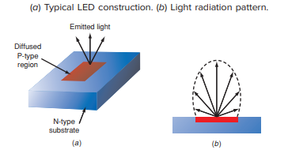
Light-Emitting Diodes

Slide 7
Laser Diodes
The other commonly used light transmitter is a laser, which is a light source that emits coherent monochromatic light. Monochromatic light is a pure single frequency light.
Although an LED emits red light, that light covers a narrow spectrum around the red frequencies.
Coherent refers to the fact that all the light waves emitted are in phase with one another. Coherence produces a focusing effect on a beam so that it is narrow and, as a result, extremely intense

Slide 8
Injection Laser Diode
The most widely used light source in fi ber-optic systems is the injection laser diode (ILD), also known as a Fabry-Perot (FP) laser.
At some current level, it emits a brilliant light. The physical structure of the ILD is such that the semiconductor structure is cut squarely at the ends to form internal reflecting surfaces.
One of the surfaces is usually coated with a reflecting material such as gold. The other surface is only partially reflective.

Slide 9
Injection Laser Diode (WORKING)
When the diode is properly biased, the light is emitted and bounces back and forth internally between the reflecting surfaces.
The distance between the reflecting surfaces has been carefully measured so that it is some multiple of a half wave at the light frequency.
The bouncing back and forth of the light waves causes their intensity to reinforce and build up.

Slide 10
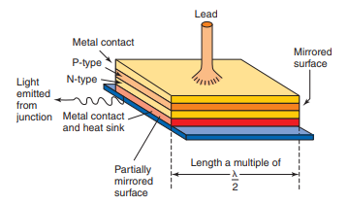
Injection Laser Diode

Slide 11
Advantages of ILD
Injection laser diodes are capable of developing light power up to several watts. They are far more powerful than LEDs and, therefore, are capable of transmitting over much longer distances.
Another advantage ILDs have over LEDs is their ability to turn off and on at a faster rate. High-speed laser diodes are capable of gigabit per second digital data rates.

Slide 12
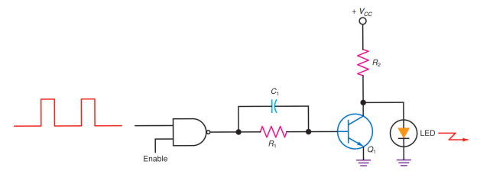
Light Transmitters Circuit

Slide 13
Light Detectors
The receiver part of the optical communication system is relatively simple. It consists of a detector that senses the light pulses and converts them to an electric signal.
This signal is amplified and shaped into the original serial digital data. The most critical component is the light sensor.

Slide 14
Types of Light Detectors
Photodiode
Phototransistor
PIN Diode
Avalanche Diode

Slide 15
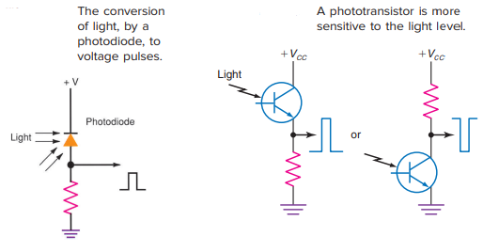
Light Detectors

